Slide 1


PC Builder VR-Game
Team 4
Siriwat, Niklas, Aleksi, Juho, Max

Slide 2

Concept
The goal of the game is to teach the player how to build a pc.
The AI NPC Assistant will be there to assist the player to build the pc. There is also a TV for additional assistance.

Slide 3
Setting
The game takes place in a room with a table that has teleport areas around it.
The player will be able to make the pc bigger to put the screws and the wiring in the case.

Slide 4
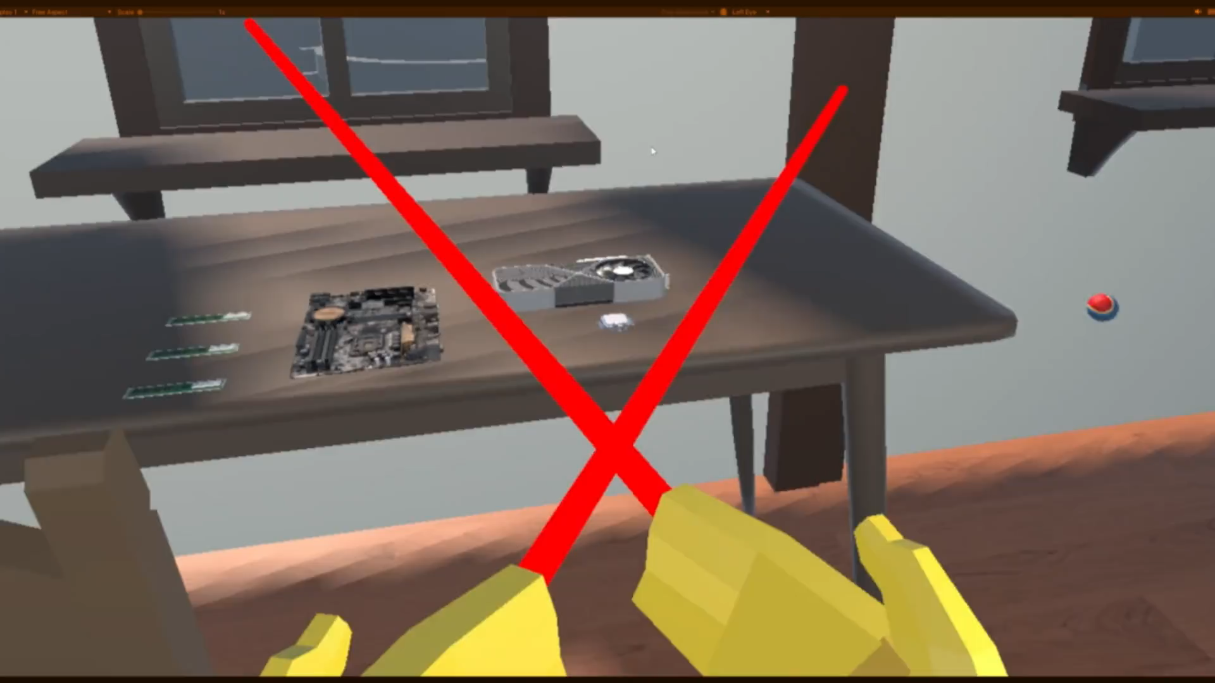

Slide 5

Thank you!

